Slide 1

Behavior-Driven Development
with
Cucumber
by Žilvinas Kučinskas & Martynas Kazlauskas

Slide 2

Content
BDD, aka Behavior-Driven Development
Cucumber tool
People different thoughts about Cucumber
Live coding
Questions & answers
Questions for audience

Slide 3
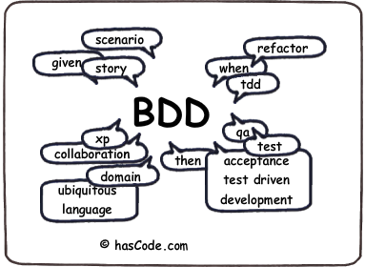

What is BDD?
BDD is a second-generation, outside-in, pull-based, multiple-stakeholder, multiple-scale, high-automation, agile methodology. It describes a cycle of interactions with well-defined outputs, resulting in the delivery of working, tested software that matters.
--- Dan North @ “Agile specifications,
BDD and Testing eXchange “,
London 2009

Slide 4
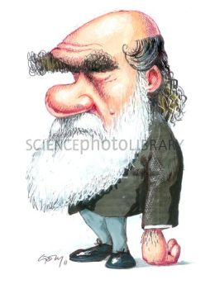
User stories
Title (one line describing the story)
Narrative:
As a [role]
I want [feature]
So that [benefit]
Acceptance Criteria: (presented as Scenarios)
Scenario 1: Title
Given [context]
And [some more context]...
When [event]
Then [outcome]
And [another outcome]...
Scenario 2: ...

Slide 5
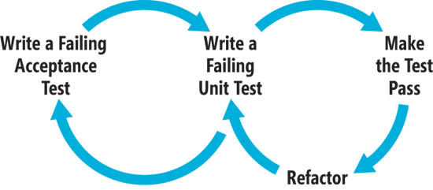
Methodology
Change the way of development
Focus on behavior not only internal structure
Ease the difficulty of communication
BDD life cycle

Slide 6
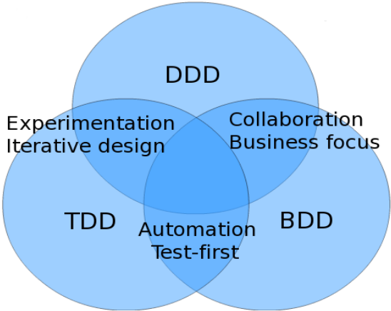
Second-generation methodology
BDD takes good habits from TDD and DDD:
Working outside-in, starting from a business or organisational goal
Using examples to clarify requirements
Developing and using a ubiquitous language

Slide 7








Ubiquitous language
Architect
Senior developer
Analyst
LANGUAGE, STORIES
Tester
Business analyst
WHAT?
Product owner
Mid-developer
Junior developer

Slide 8

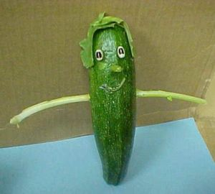


What is cucumber?

Slide 9

Also Cucumber
Cucumber – a tool used in BDD to write acceptance tests.

Slide 10

Benefits
The killer feature of Cucumber is the ease of web workflow testing
Easy to set up
Multiple report formats
Supports writing specifications in about 40 spoken languages
Generates tricky parts of the code
Integrates nicely with the rest of the development ecosystem. (Plain text)
You can use Cucumber with .Net and JVM languages almost natively
Integrated with all the most popular web testing libraries
Allows test indexing
Nice!!! I will definitely check it out!

Slide 11
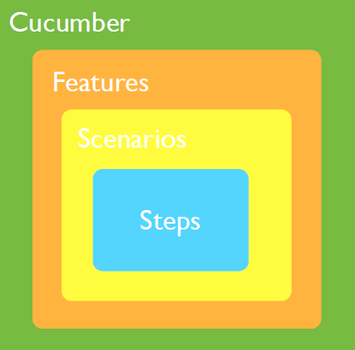
Structure

Slide 12
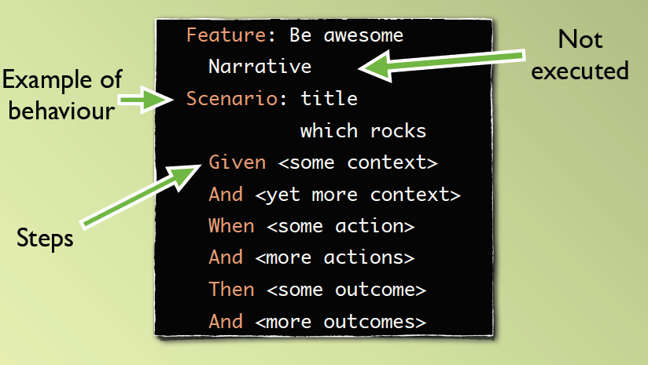
Cucumber feature

Slide 13
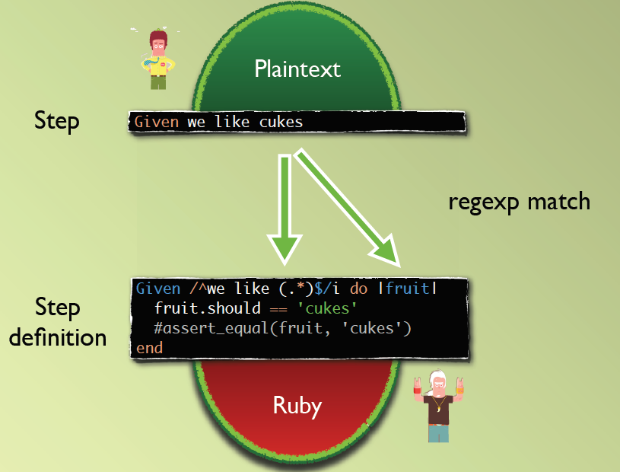
Step and step definition

Slide 14
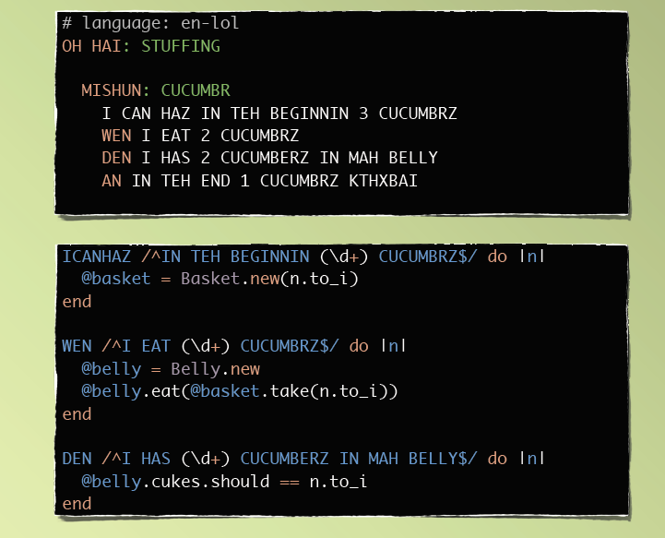
Supported languages

Slide 15

Is Cucumber just a scam?
David Heinemeier Hansson recently wrote on his blog:
Don’t use Cucumber unless you live in the magic kingdom of non-programmers-writing-tests (and send me a bottle of fairy dust if you’re there!)
Danish programmer and the creator of the popular Ruby on Rails web development framework

Slide 16
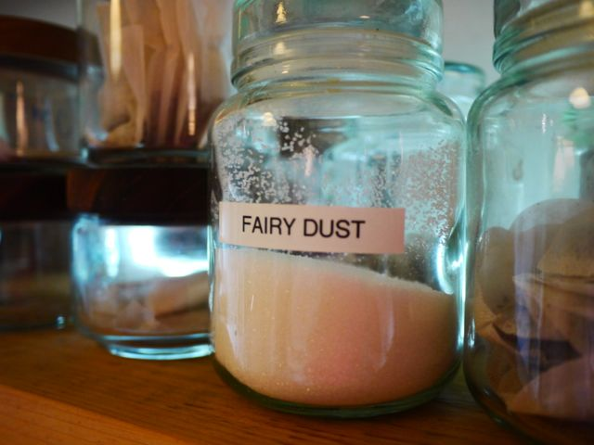
What I can say to him?

Slide 17

Let’s hear some people thoughts
Lisa Clark(team-leader programmer in a big company) in her blog writes:
I live in a magic kingdom and work in a castle (the Rackspace Castle). I’ve been using Cucumber on a RESTful web service project since project inception over a year ago… Currently our BDD sessions include the BA, QA, Dev Lead, and Developer. We will pull in the PO or architects as needed.
Here’s how Lisa’s team have benefitted from using BDD:
We’ve found value in the BDD documentation process and obtaining a shared understanding of what we’re building before it’s actually built. The added benefit of having executable requirements and an automated functional test suite that’s ready when the code is ready is icing.

Slide 18
Final Lisa’s opinion
Lisa doesn’t see the primary benefit of Cucumber as being the testing, it’s the shared understanding that the team have built from writing the tests together. In Lisa’s magic kingdom, non-programmers don’t sit about writing tests on their own, they collaborate. And look the confidence that the whole team gets from that shared understanding:
The developers on my team have a strong level of confidence when delivering a story that all scenarios have been coded and are working as we said they should be. The QA knows up front exactly what we’re delivering with the story. I have confidence that regardless of which developer owned the story, all expected scenarios are coded and tested.
WTF SO MUCH TEXT!!!!!!

Slide 19


Live coding session
You can download source here
Or here
https://github.com/l33tas/pristatymas

Slide 20

Questions

Slide 21
Question for the audience
Do you still need to do unit testing when using Cucumber? Explain why?
WHAT??

Slide 22
Answer
Do you still need to do unit testing when using Cucumber? Explain why?
Definitely yes!! Unit testing helps to build the thing right while Cucumber/BDD helps to build the right thing
WHAT?

Slide 23
Question for the audience
Describe BDD life cycle
WHAT??

Slide 24
Question for the audience
Explain how BDD life cycle differs from TDD?
Let’s remember!!

Slide 25
Sources
The Cucumber Book: Behaviour-Driven Development for Testers and Developers
http://blog.mattwynne.net/category/bdd/
http://en.wikipedia.org/wiki/David_Heinemeier_Hansson
http://devcheatsheets.wordpress.com/2012/10/30/cucumber-goodness/
http://cukes.info/
http://dannorth.net/whats-in-a-story/
http://cuke4ninja.com
http://blog.josephwilk.net/ruby/futureruby-talk-cucumbered.html
http://msdn.microsoft.com/en-us/magazine/gg490346.aspx

